Slide 1
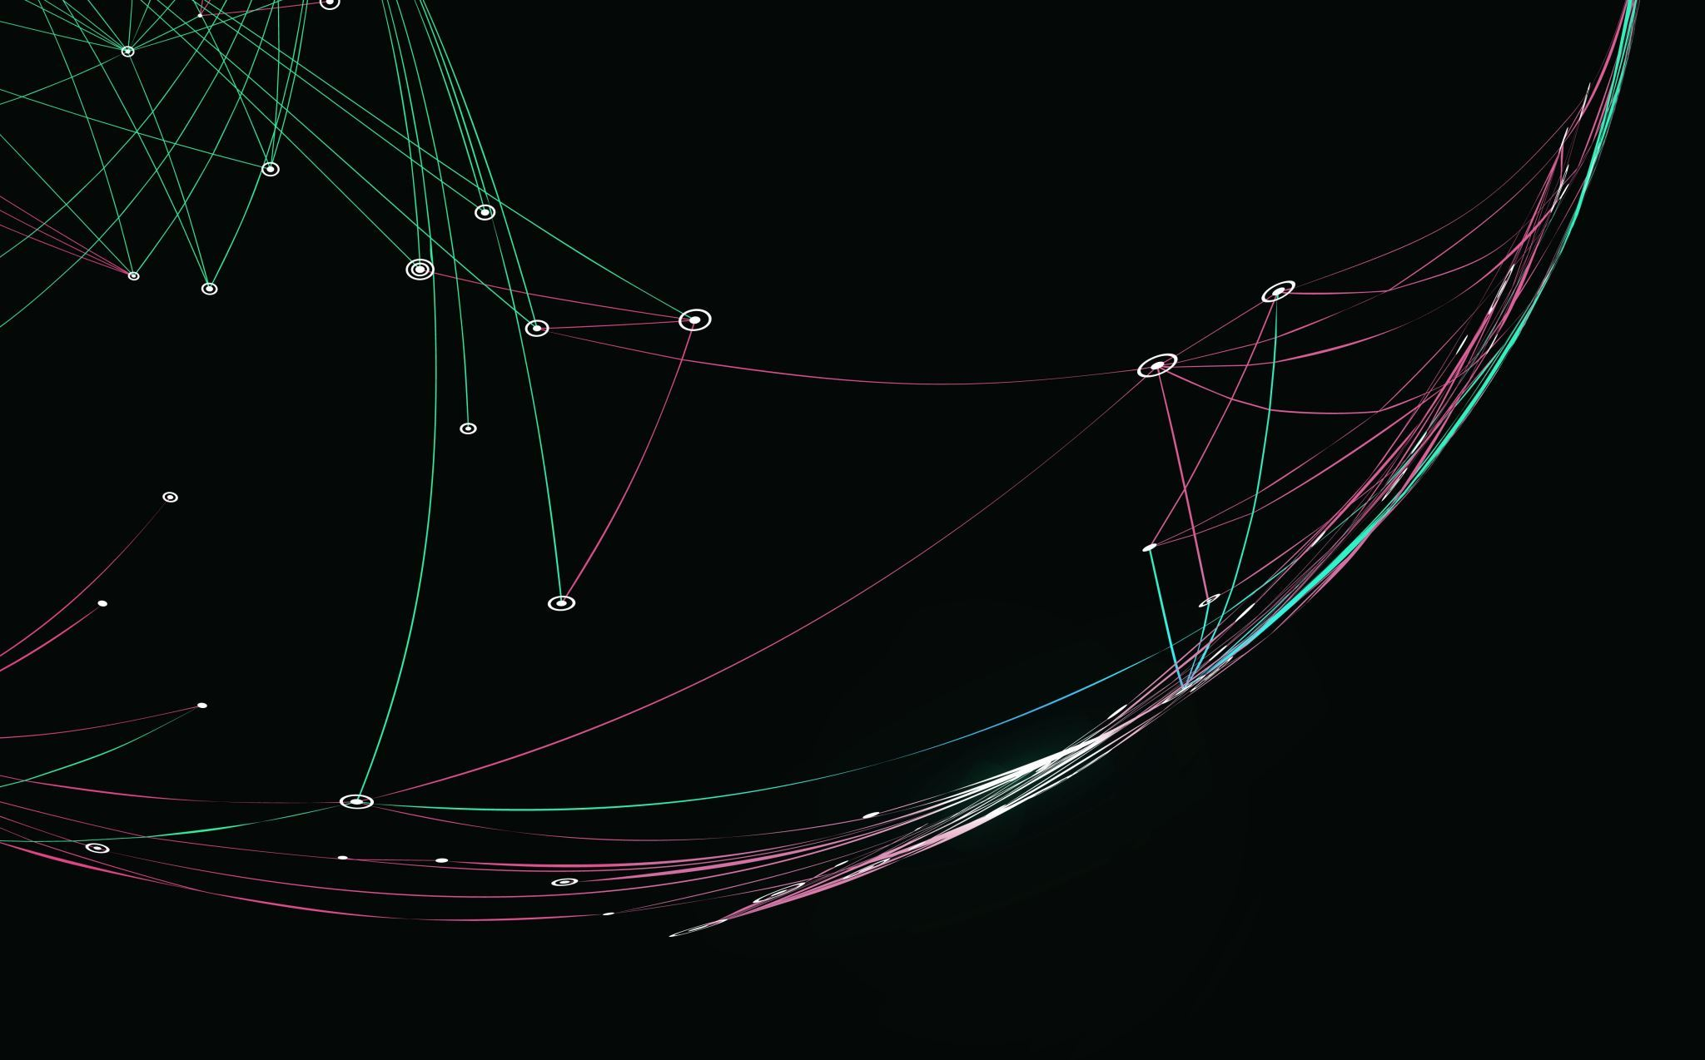


What is High Performance Computing and why do we need a mini version?
CarpentriesOffline
Jannetta Steyn

Slide 2
What is a High Perfomance Computer (HPC)?

Slide 3
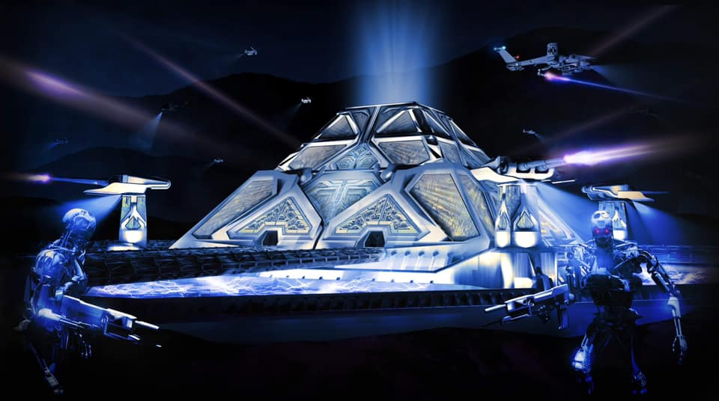
Skynet Pyramid
Fan art: https://www.facebook.com/photo/?fbid=606678917373695&set=a.121895769185348

Slide 4
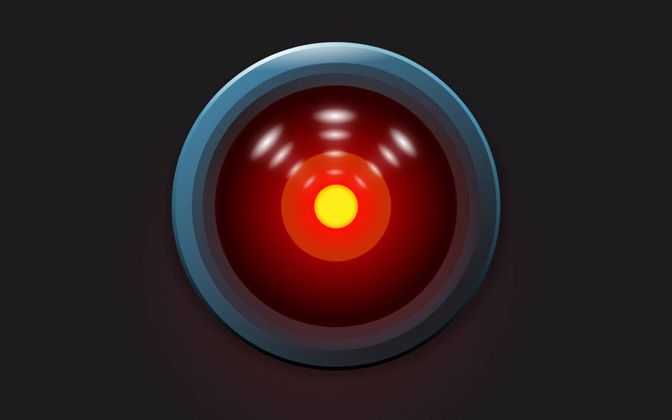
Hal 9000

Slide 5
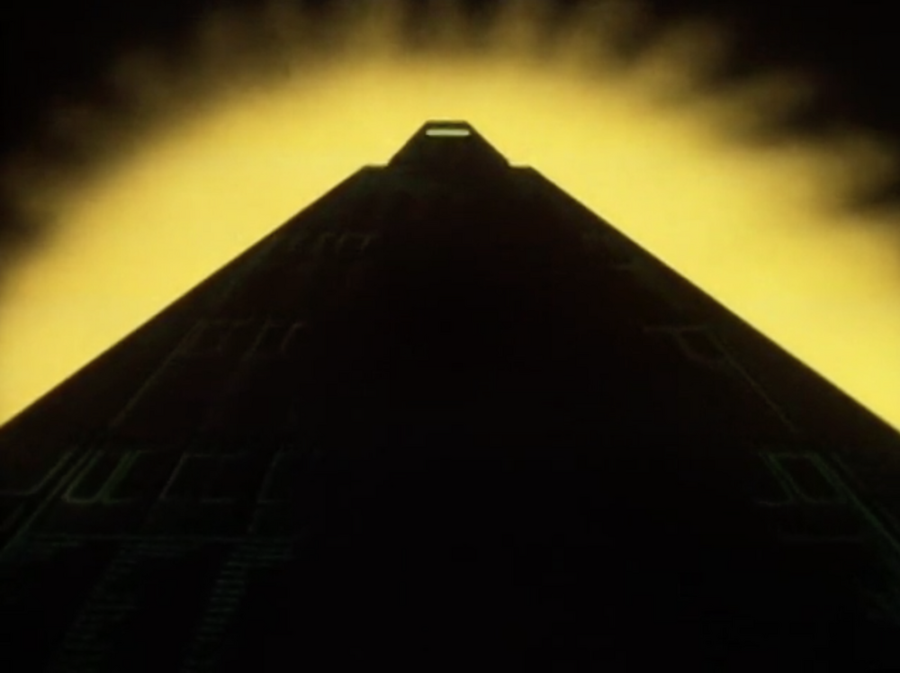
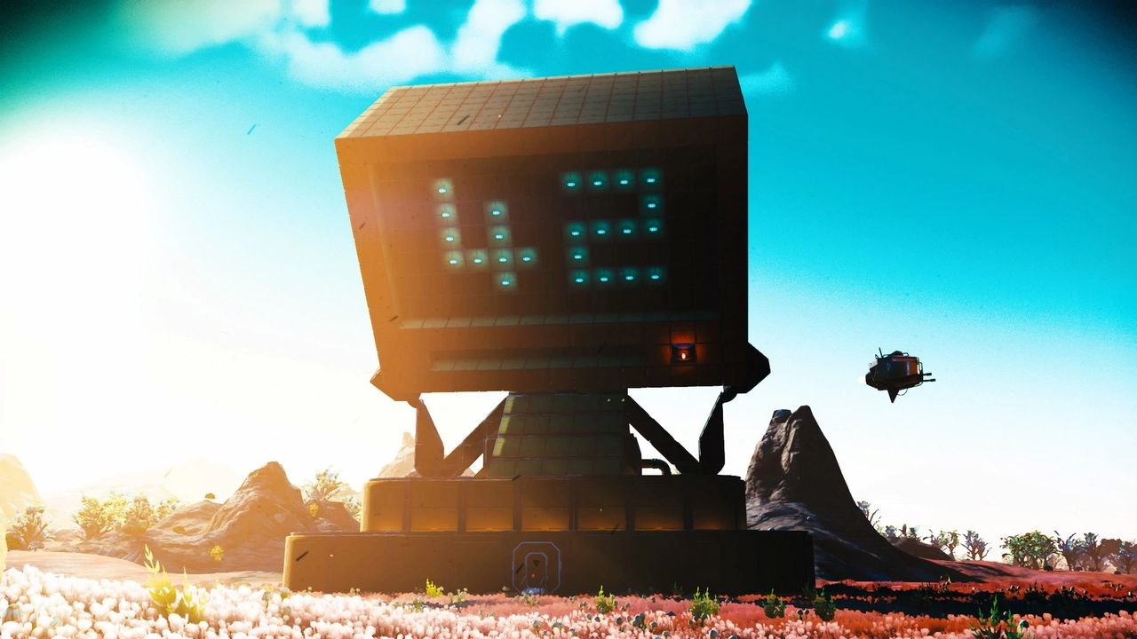
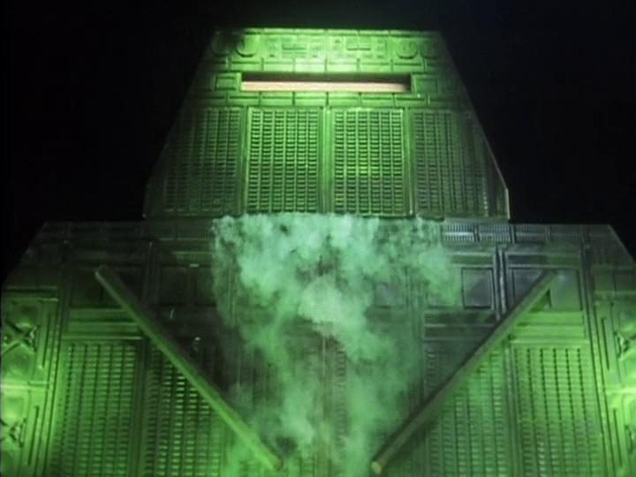

Deep Thought
https://hitchhikers.fandom.com/wiki/Deep_Thought

Slide 6

Blue Gene

Slide 7
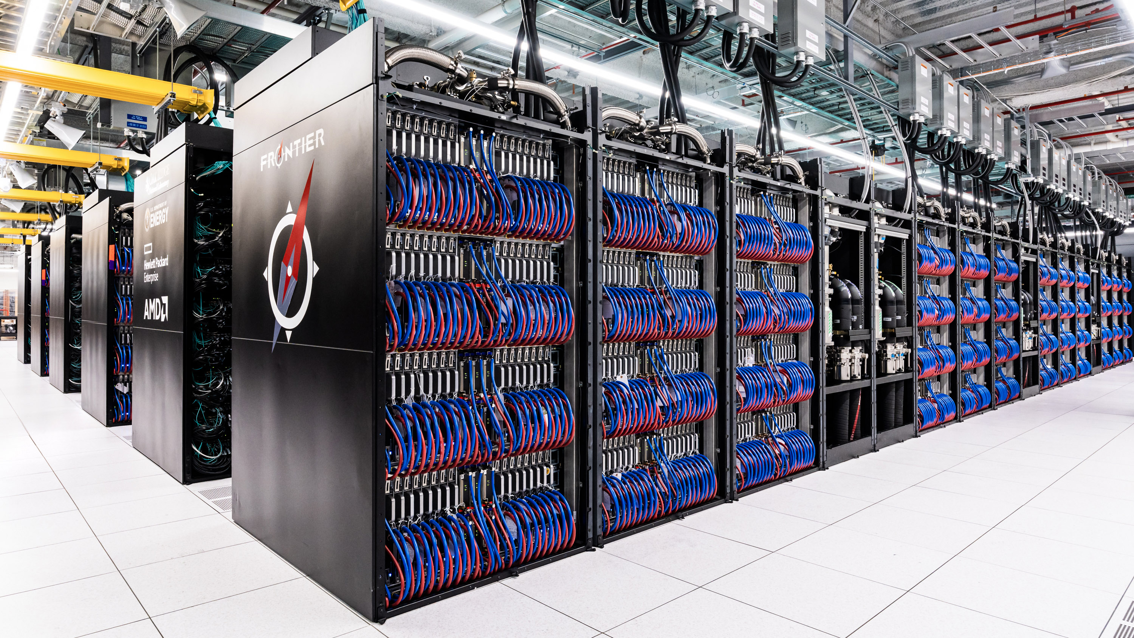
Frontier
Frontier, an exascale-class machine at Oak Ridge National Laboratory.

Slide 8
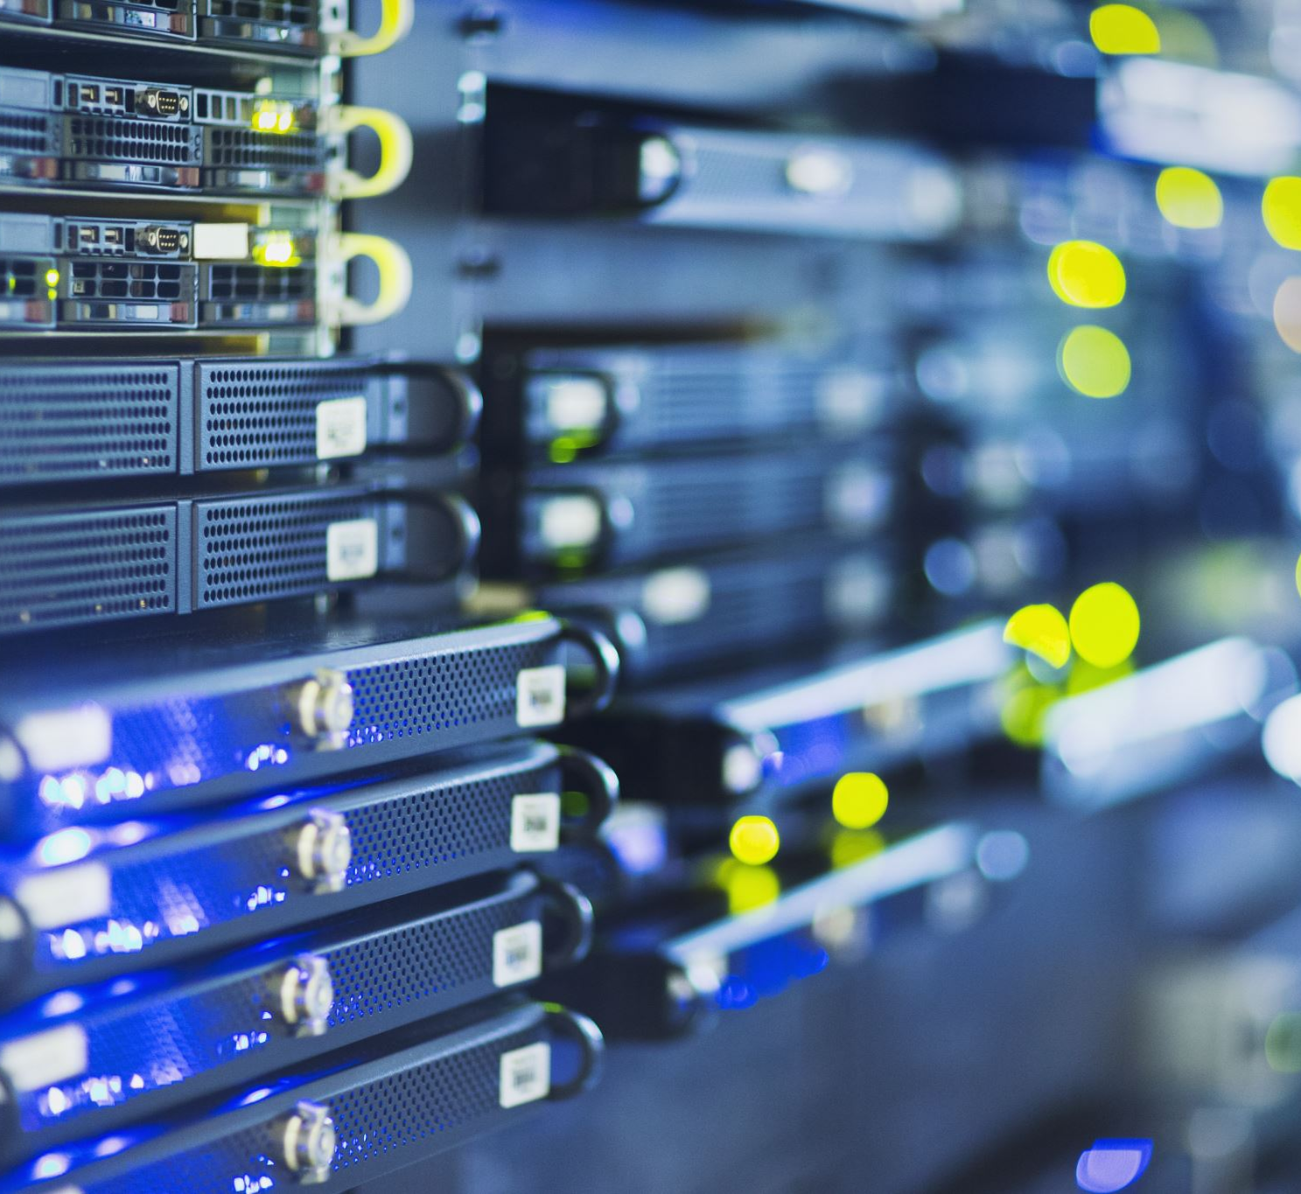
High Performance Computing
High-performance computing (HPC) uses supercomputers and computer clusters to solve advanced computation problems. (Wikipedia)
High performance computing (HPC) is the practice of aggregating computing resources to gain performance greater than that of a single workstation, server, or computer. (Google)

Slide 9
Why a mini version?
Hardware less abstract
Real system are busy doing actual research (85 - 95% load on systems)
Fear amongst learners that they are going to break the multi-million system they are playing on
Resource limits more apparent
More control over the environment
No need to have accounts on a real HPC
Own access point, so no need to get people on university network

Slide 10
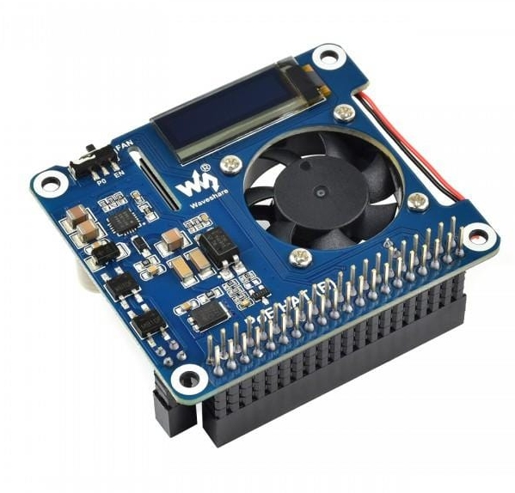
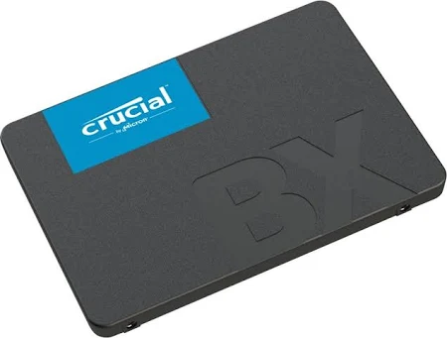
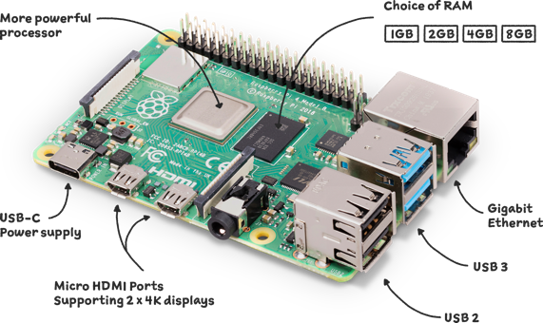
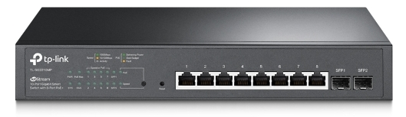
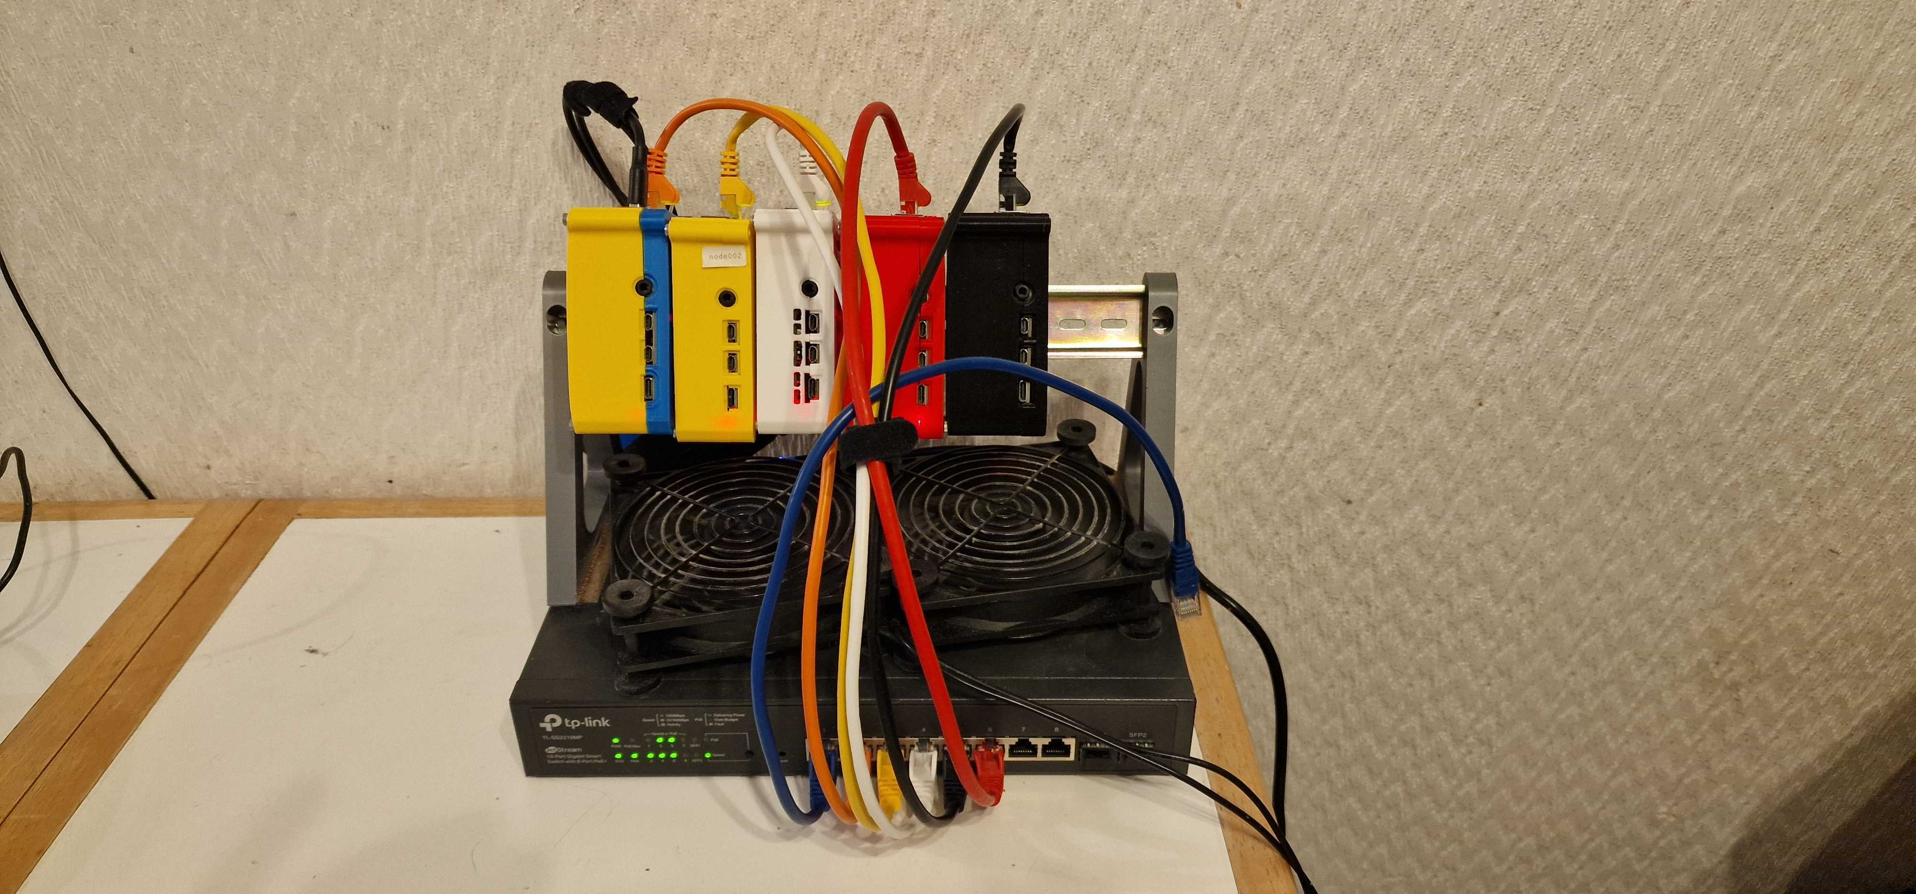
What does it look like?

Slide 11
What is different?
Downloadable image for booting RPi
No specialised HPC knowledge required to install and configure software and hardware
Updates and updated instructions
Adapted lessons
Expandable with regards to hardware and software

Slide 12
Status
EasyBuild - for installing software
Converting HPC lesson
Documenting
Scripting
Updating website
Volunteers needed!

Slide 13
All Done! Questions

